Slide 1
The Entity Relationship Model
Database Management
Overview
Entities Attributes Relationships
Weak Entity Types ISA relationships
An example of a conceptual (high-level) data model
Useful for design before moving to a lower level model (e.g. relational)
Alternatives include
  UML (Unified Modelling Language) and
  ODL (Object Description Language)
Copyrights and original material belongs to: Prof. Peter Wood
Email: ptw@dcs.bbk.ac.uk
Web: http://www.dcs.bbk.ac.uk/~ptw/

Slide 2
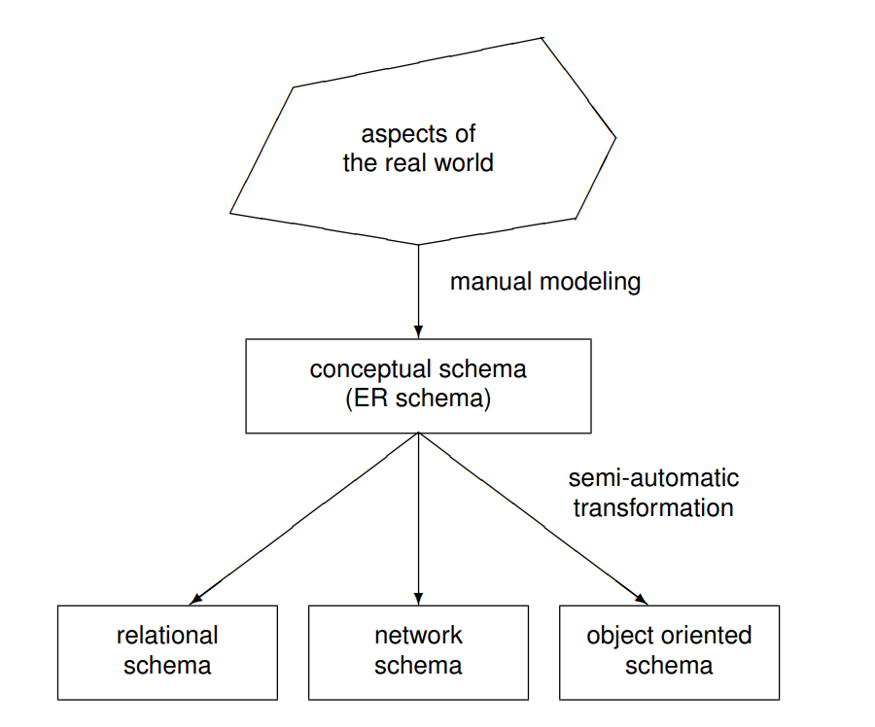
Modelling Steps
Database Management
Overview
Entities Attributes Relationships
Weak Entity Types ISA relationships

Slide 3
The Components of the ER Model
Database Management
Overview
Entities Attributes Relationships
Weak Entity Types ISA relationships
Structural part
  entity types
  attributes
  relationship types
Integrity constraints
  primary keys for entity types and relationship types, and
  multiplicity (cardinality) constraints for relationship types

Slide 4
The Main Advantages of the ER Model
Database Management
Overview
Entities Attributes Relationships
Weak Entity Types ISA relationships
The diagrams (ERDs) associated with entity-relationship models
are relatively simple
are user-friendly
can provide a unified view of data, which is independent of any implemented data model

Slide 5

The Building Blocks of an ERD
Database Management
Entities and entity types (entity sets)
Relationships and relationship types
Attributes, keys and roles
Overview
Entities Attributes Relationships
Weak Entity Types ISA relationships

Slide 6
Entities and Entity Types
Database Management
Overview
Entities Attributes Relationships
Weak Entity Types ISA relationships
An entity is a “thing” that exists and can be uniquely identified, e.g., an individual person.
An entity type (or entity set) is a collection of similar entities, e.g., a collection of people.
An entity type
is similar to a class in object-oriented languages
has associated attributes, which represent properties of the entities comprising the entity type
is represented in an ERD by a rectangle

Slide 7
Attributes
Database Management
Overview
Entities Attributes Relationships
Weak Entity Types ISA relationships
Attribute names (or simply attributes) are properties of entity types.
Each attribute usually has only simple values (e.g. integers or character strings)
  represented by an oval in an ERD, with a line to the rectangle representing its entity type
Sometimes multi-valued attributes (e.g. Phones) are allowed
  represented by a double oval in an ERD

Slide 8
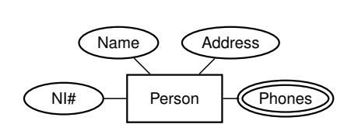
Example of Entity Type and Attributes
Database Management
Overview
Entities Attributes Relationships
Weak Entity Types ISA relationships
Each Person has a single Name, Address and National Insurance number (NI#)
Each Person can have many Phones

Slide 9
Domain
Database Management
The domain of an attribute is the set of is the set of values allowed in an attribute
Example:
Rooms in hotel (1-300)
Age (1-99)
Married (yes, no)
Nationality (Nepalese, Indian, American, or British)
Colors (Red, Yellow, Green)
For the relational model, it is a requirement that each part of a tuple be atomic.
Also, each value in the tuple must be of some basic type, like a string or an integer.
Atomic: it cannot be broken into more pieces
Overview
Entities Attributes Relationships
Weak Entity Types ISA relationships

Slide 10
Relationship Types
Database Management
A relationship type is an association between two or more entity types.
Overview
Entities Attributes Relationships
Weak Entity Types ISA relationships
Relationship types are represented in an ERD by diamond shapes,
with lines to each of the rectangles representing entity types involved in the association
Example of a relationship type Teaches between entity type Lecturer and entity type Student:
Lecturer
Student
Teaches

Slide 11





Relationships
A relationship is an instance of a relationship type, i.e., it is the set of associations between the entities comprising the entity types associated by the relationship type.
Database Management
Overview
Entities Attributes Relationships
Weak Entity Types ISA relationships
Above diagram is not an ERD
Entities for one entity type on left (green)
Entities for another entity type on right (red)
Lines between entities show the relationship

Slide 12
Multiplicity Constraints in Relationship Types
Database Management
Overview
Entities Attributes Relationships
Weak Entity Types ISA relationships
many-to-one (or one-to-many)
An Employee Works in one Department or a Department has many Employees.
one-to-one
A Manager Heads one Department and vice versa.
many-to-many
A Lecturer Teaches many Students and a Student is Taught by many Lecturers.

Slide 13
Example of many-to-one relationship type
Database Management
Overview
Entities Attributes Relationships
Weak Entity Types ISA relationships
Employee
Department
Works-in
The arrowhead is drawn at the “one” end of the relationship type
Each Employee Works-in one Department
Each Department has many Employees working in it

Slide 14






Example of many-to-one relationship
Database Management
Overview
Entities Attributes Relationships
Weak Entity Types ISA relationships

Slide 15
Example of one-to-one relationship type
Database Management
Overview
Entities Attributes Relationships
Weak Entity Types ISA relationships
Manager
Office
Occupies
The arrowhead is drawn at both ends of the relationship type
Each Manager Occupies one Office
Each Office has one Manager occupying it

Slide 16
Example of one-to-one relationship
Database Management
Overview
Entities Attributes Relationships
Weak Entity Types ISA relationships

Slide 17
Example of many-to-many relationship type
Database Management
Overview
Entities Attributes Relationships
Weak Entity Types ISA relationships
Lecturer
Student
Teaches
No arrowheads are drawn
Each Lecturer Teaches many Students
Each Student is taught by many Lecturers

Slide 18
Example of many-to-many relationship
Database Management
Overview
Entities Attributes Relationships
Weak Entity Types ISA relationships

Slide 19
Multiple relationship types
There may be more than one relationship type between two entity types.
Database Management
Overview
Entities Attributes Relationships
Weak Entity Types ISA relationships
Teaches
Lecturer
Student
Tutors
Teaches relationship type is many-to-many
Tutors relationship type is one-to-many (from Lecturer to Student)

Slide 20
Participation Constraints in Relationships
Database Management
Optional / partial relationship
  e.g., an Employee may or may not be assigned to a Department
  Participation of entity (e.g., Employee) in relationship is said to be partial
  Indicated by default single line in our notation
  (Sometimes indicated by cardinality constraint of 0..*)
mandatory relationship
  e.g., every Course must be Taught by at least one Lecturer
  Participation of entity (e.g., Course) in relationship said to be total
  Indicated by double lines in our notation
  (Sometimes indicated by cardinality constraint of 1..*)
Overview
Entities Attributes Relationships
Weak Entity Types ISA relationships

Slide 21
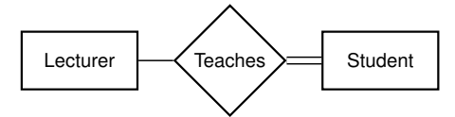
Example of Participation Constraints
Database Management
Overview
Entities Attributes Relationships
Weak Entity Types ISA relationships
Lecturer
Student
Teaches
Each Lecturers may not Teach any Students
Each Student must be taught by at least one Lecturer
Lecturer
0..*
Teaches
1..*
Student

Slide 22
Binary Versus Multiway Relationship Types
Database Management
Overview
Entities Attributes Relationships
Weak Entity Types ISA relationships
Supplier
Supplies
Part
Project
each supplier may supply different parts to different projects
Supplies is an example of a ternary relationship type

Slide 23
Keys and Superkeys
Database Management
Definition of a superkey. A set of attributes of an entity type is a superkey if for each entity, say e, over that type, the set of values of the attributes in the superkey uniquely identifies e.
e.g., a Person may be uniquely identified by {Name, NI#}
Overview
Entities Attributes Relationships
Weak Entity Types ISA relationships
Definition of a key. A key for an entity type is a superkey which is minimal.
e.g., to uniquely identify a Person, NI# is sufficient
  simple keys are single attribute keys, such as Emp# and NI#.
  composite keys are keys having more than one attribute, such as {Department, University} and
{Name, Address}.

Slide 24
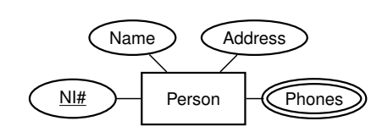
Definition of primary key of an entity type. A primary key is a key that has been designated as such by the database designer.
Database Management
Overview
Entities Attributes Relationships
Weak Entity Types ISA relationships
The primary key guarantees logical access to every entity.
Attributes that are members of the primary key of an entity type are underlined in an ERD.
Name Address
Person
NI#
Phones

Slide 25
Cyclic Relationship Types
Database Management
Overview
Entities Attributes Relationships
Weak Entity Types ISA relationships
Definition. A cyclic relationship type (also called recursive) is a relationship type between two occurrences of the same entity type.
Examples:
Marriage between Person and itself.
Parent-Child between Person and itself.
Part-Sub-Part between Part and itself.
With each entity type in a cyclic relationship type we associate a role, represented by labels on lines in an ERD.

Slide 26
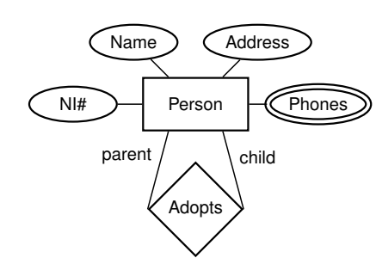
Example of a Cyclic Relationship Type with Roles
Database Management
Overview
Entities Attributes Relationships
Weak Entity Types ISA relationships
Name Address
Person
NI#
Phones
parent
child
Adopts
Roles are specified by “parent” and “child” labels.

Slide 27
Relationship Types with Attributes
Database Management
Examples:
attribute Date associated with the relationship type Married
attribute Price associated with the relationship type Supplies
Overview
Entities Attributes Relationships
Weak Entity Types ISA relationships
Price
Supplier
Supplies
Part
Each Supplier Supplies a Part at a certain Price.

Slide 28
Weak Entity Types
Database Management
Definition. A Weak Entity Type is an entity type that does not have sufficient attributes to form a primary key.
The existence of a weak entity depends on the existence of an identifying or owner entity type.
The relationship between them is called an
identifying (ID) relationship.
The identifying relationship type is always many-to-one from the weak entity type to the identifying entity type.
The weak entity type must have a discriminator (one or more attributes) for distinguishing among its entities.
For example, in an employees database, Child entities exist only if their corresponding Parent employee entity exists.
Overview
Entities Attributes Relationships
Weak Entity Types ISA relationships

Slide 29
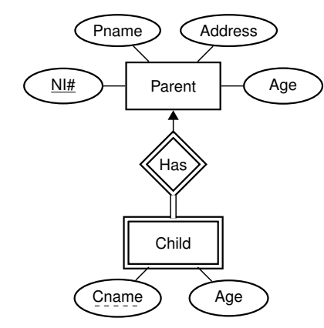
Weak Entity Type and ID Relationship Type
Database Management
Pname Address
Overview
Entities Attributes Relationships
Weak Entity Types ISA relationships
Parent
NI#
Age
Has
Total participation
Indicated by double lines
Same as: 1…
Child
Weak Entity
discriminator
Cname
Age

Slide 30
Weak Entity Types in an ERD
Database Management
Overview
Entities Attributes Relationships
Weak Entity Types ISA relationships
A weak entity type is identified by a double rectangle.
The discriminator is underlined by a dashed line.
An identifying relationship is identified by a double diamond.
The fact that the existence of the weak entity requires the existence of an owner entity is captured by the total participation of the weak entity type in the relationship (double line).
The primary key of a weak entity type is the combination of the primary key of its owner type and its discriminator, e.g., (NI#, Cname) for Child.

Slide 31
ISA Relationship Types
Database Management
Overview
Entities Attributes Relationships
Weak Entity Types ISA relationships
When an entity type contains certain entities that have special properties not shared by all entities, this suggests two entity types should be created with an ISA relationship type between them.
Also known as generalisation/specialisation.
E.g. An Employee ISA Person and a Student ISA Person (see next slide)
If Employee ISA Person then Employee inherits all the attributes of Person.

Slide 32
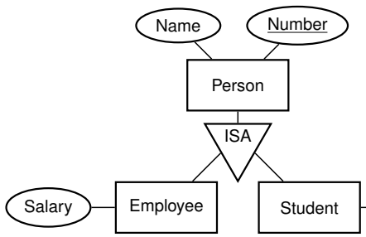
ISA Relationships
Database Management
Overview
Entities Attributes Relationships
Weak Entity Types ISA relationships
Name
Number
Person
ISA
Student
Salary Employee
Degree
Attributes of Employee: Name, Number and Salary.
Attributes of Student: Name, Number and Degree.

Slide 33
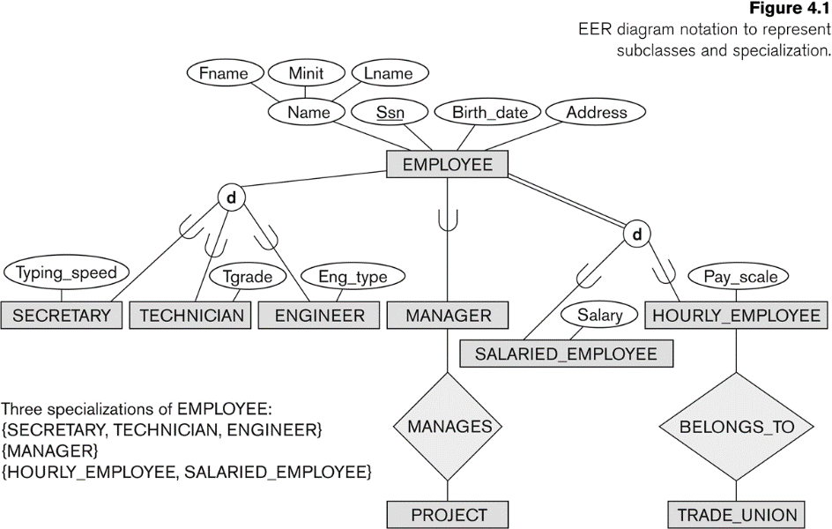
Specialization

Slide 34
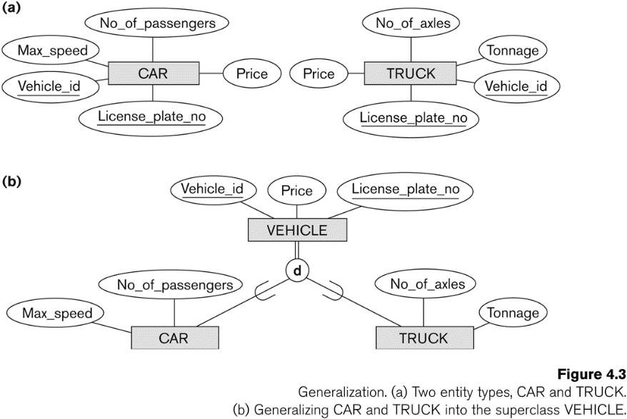
Generalization

Slide 35
Informal Method for Constructing an ERD
Database Management
Identify the entity types (including weak entity types) of the application.
Identify the relationship (including ISA and ID) types. 3.Classify each relationship type identified in step 2
according to its multiplicity, i.e. if it is a one-to-one, many-to-one or many-to-many.
Determine the participation constraints for each entity type in each relationship type.
Draw an ERD with the entity types and the relationship types between them.
Identify the attributes of entity and relationship types and their underlying domains
Identify a primary key for each entity type. 8.Add the attributes and primary keys to the ERD
drawn in step 5.
Overview
Entities Attributes Relationships
Weak Entity Types ISA relationships

Slide 36
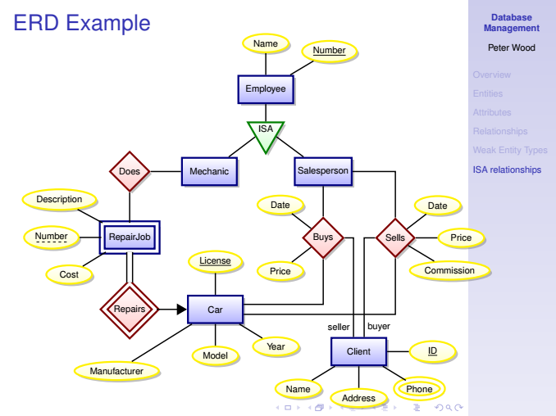


























ERD Example
Database Management
Name
Number
Overview
Entities Attributes Relationships
Weak Entity Types ISA relationships
Employee
ISA
Does
Mechanic
Salesperson
Description
Date
Date
Number
RepairJob
Buys
Sells
Price
License
Cost
Price
Commission
Repairs
Car
seller buyer
Year
Client
ID
Model
Manufacturer
Name
Phone
Address

Slide 37
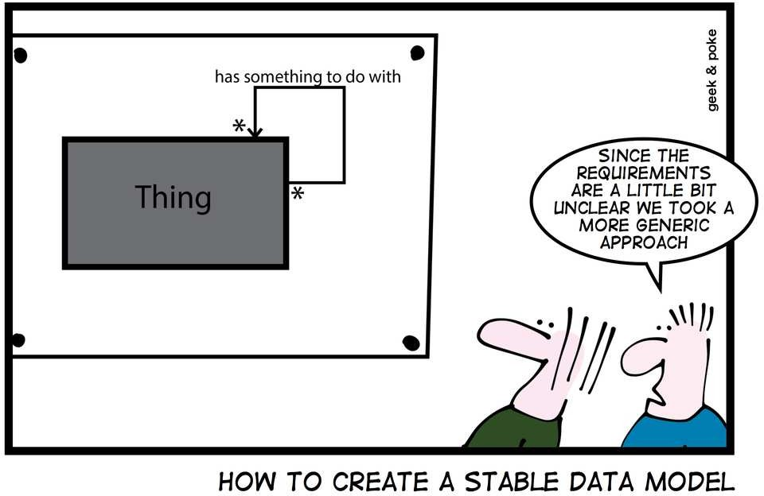
Generic model
Database Management
And then there’s always the generic approach:
Overview
Entities Attributes Relationships
Weak Entity Types ISA relationships

Slide 38
For more information
Database Management
Overview
Entities Attributes Relationships
Weak Entity Types ISA relationships
See, e.g.,
Chapter 12 of Connolly and Begg.
Chapter 7 of Silberschatz et al.
Chapter 4 of Ullman and Widom.

